Slide 1
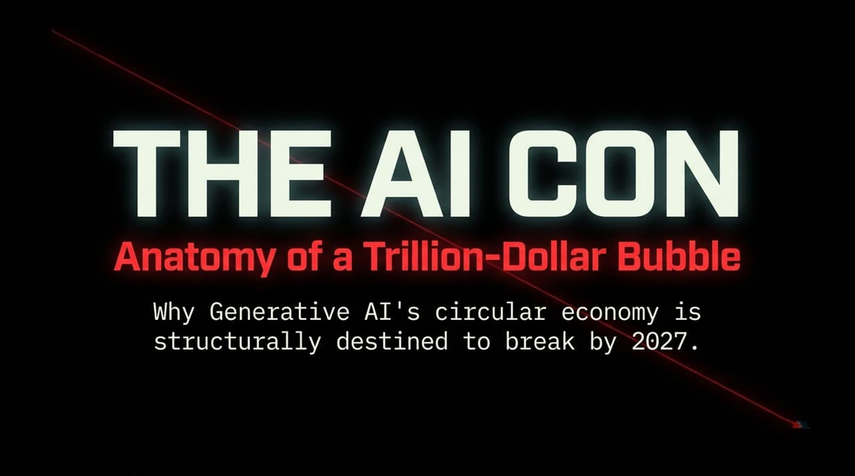
Notes:
Opening Hook:
Welcome, everyone. Today, we are going to look behind the curtain of what is currently touted as the greatest technological shift of our generation. The tech industry and Wall Street tell us that Generative AI is an unstoppable revolution. However, when you look past the slick marketing and examine the core math, a different picture emerges: Generative AI operates like a circular economy that is structurally destined to collapse by 2027.
Core Talking Points:
The Product: Sold as 'magic' and Artificial General Intelligence (AGI), but at its core, it remains a probabilistic, unreliable 'half-assed answering machine' that hallucinates and degrades the digital ecosystem.
The Economics: We are witnessing the largest non-consensual push of consumer technology in history. Adoption is forced and heavily subsidized to mask catastrophic unit economics.
The Macro Reality: The industry’s financial growth is not driven by real, organic market demand, but by Big Tech funding unviable AI labs to simulate hyper-growth and inflate valuation metrics.
Key Takeaway:
This presentation will break down the mechanics of this bubble—from token-level unit economics to macro-level capital expenditures—and demonstrate why the current AI cycle is financially unsustainable.
https://www.youtube.com/watch?v=Lf5oqGOCRCM

Slide 2
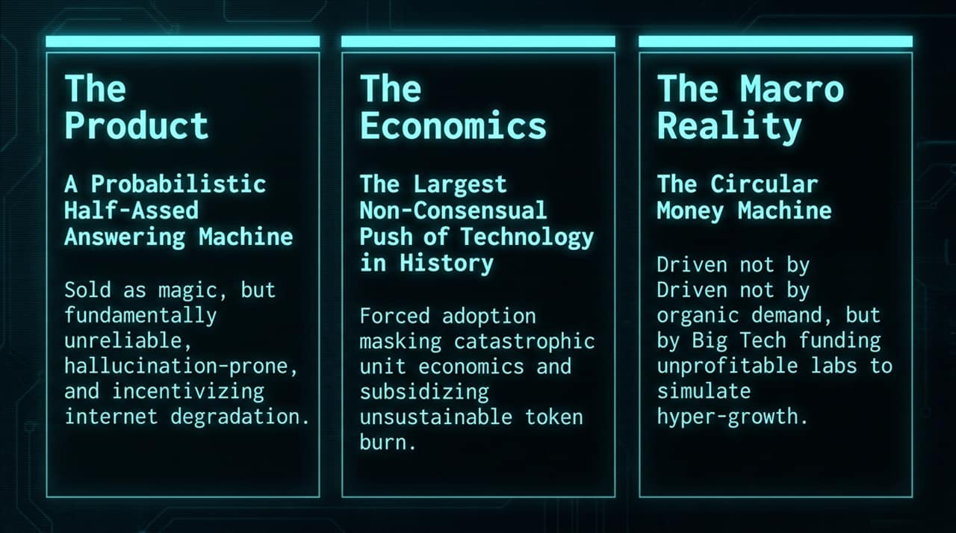
Notes:
Opening Hook:
There is a massive gap between what the AI industry promises to investors and what the software delivers in practice.
Core Talking Points:
Pitch 1: Universal Intelligence / AGI
Reality: LLMs are sophisticated autocomplete engines. They do not 'know' facts; they predict the next token probabilistically. Furthermore, performance improvements are hitting severe diminishing returns, masked primarily by tailored or rigged benchmarks.
Pitch 2: Complete Automation of White-Collar Labor
Reality: Economic data reveals zero correlation between corporate AI token spend and an increase in revenue per employee. Rather than replacing workers, it often acts as a Dunning-Kruger multiplier—giving overconfident users low-quality output that requires manual correction.
Pitch 3: Autonomous AI Agents
Reality: Edge-case failure rates remain unacceptably high for mission-critical enterprise workflows. Getting agents to perform basic tasks requires a complex 'Rube Goldberg machine' of prompts, guardrails, and secondary checkers just to mitigate hallucinations.
Key Takeaway:
The 'magic' of AI is held together by marketing hype and prompt engineering workarounds rather than fundamental scientific breakthroughs in reasoning.

Slide 3
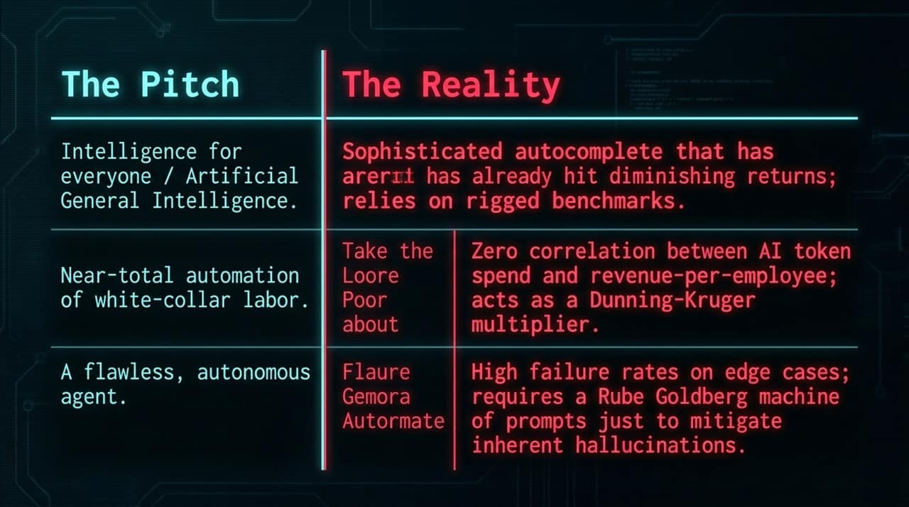
Notes:
Opening Hook:
Let’s examine the underlying cost structure. The subscription price tag you see on consumer platforms is an illusion.
Core Talking Points:
The Surface vs. Subsurface Pricing:
A typical consumer pays $20/month for a subscription like ChatGPT Plus or Claude Pro.
However, heavy usage on a $20/month tier can burn up to $400 in API compute costs.
For enterprise power users on $200/month tiers, token processing costs can escalate up to $14,000.
Artificial Demand:
The massive user adoption rates highlighted by AI companies are purely subsidized.
If AI companies charged enterprise clients or retail users the true per-million-token cost required to break even on compute and hardware depreciation, user adoption would drop significantly.
Key Takeaway:
Generative AI adoption is artificial. The tech sector is losing money on every query to simulate hyper-adoption.

Slide 4
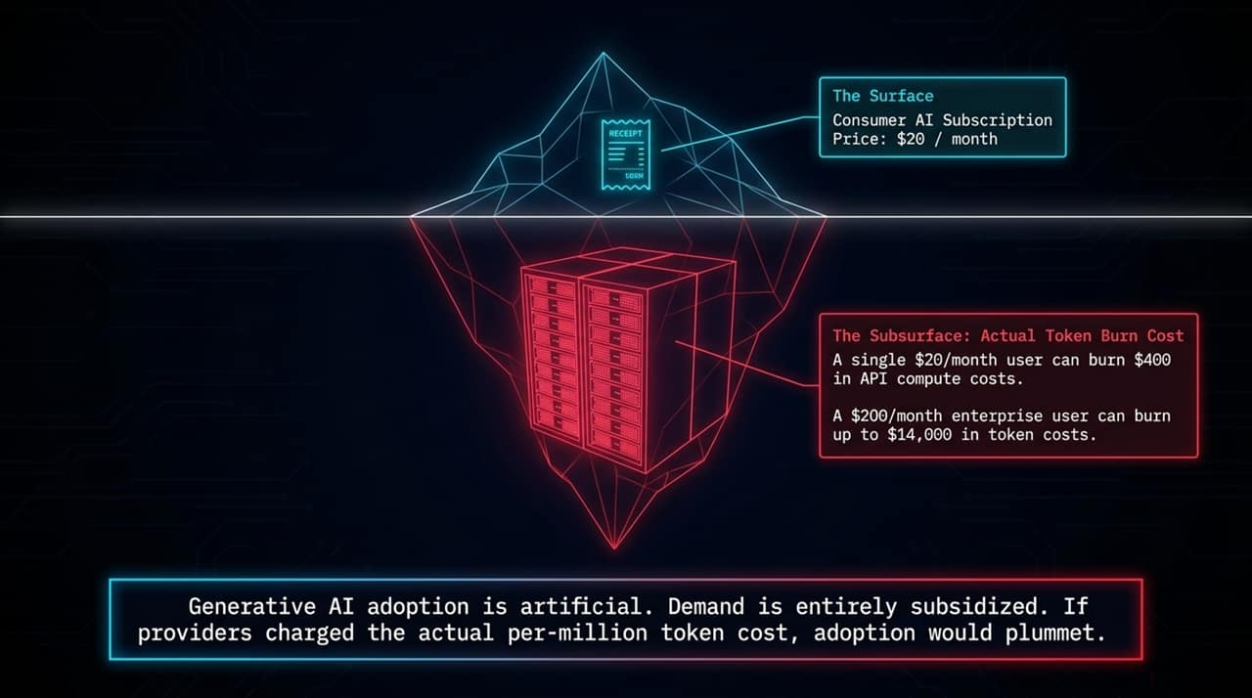
Notes:
Opening Hook:
If the economics are broken, is the technology at least improving our productivity? The evidence shows the opposite: a three-step cycle of digital degradation.
Core Talking Points:
Step 1: AI-Assisted Coding: Developers rely heavily on AI code generators, pushing vast amounts of boilerplate code to repositories. This floods codebases with subtle bugs and architectural flaws, leading to increased software downtime.
Step 2: Search Degradation: Platforms like Google prioritize generated answers over routing web traffic. This incentivizes low-cost 'SEO slop,' filling the web with synthetic, median-quality content that degrades future training data.
Step 3: The Productivity Paradox: Workers spend significant time fact-checking, editing, and troubleshooting AI-generated slop. A real-world example includes financial platforms like Bloomberg BQL hallucinating stock metrics (e.g., pricing Microsoft at $575).
Key Takeaway:
AI tools often generate extra work under the guise of productivity, creating a loop where humans clean up after machine-generated mistakes.

Slide 5
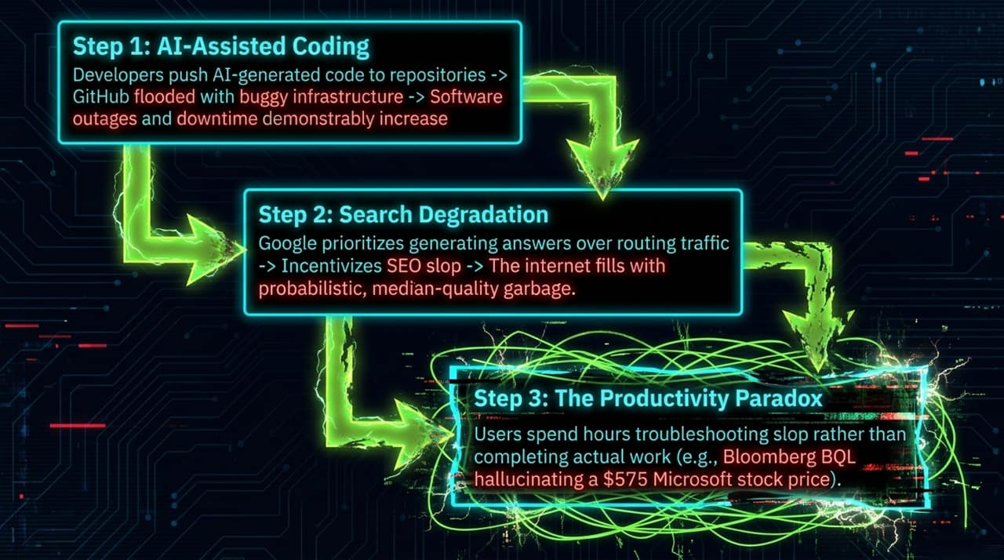
Notes:
Opening Hook:
When you step back from product metrics and look at corporate balance sheets, the math fails completely.
Core Talking Points:
Infrastructure Overshoot:
Over $1 Trillion in Capital Expenditures (Capex) is being poured into data center construction and GPU clusters. Microsoft alone spent $115 billion in Capex to support this buildout.
The Revenue Deficit:
Total organic, non-Big-Tech-subsidized AI software revenue globally sits at roughly ~$22 Billion.
Accounting Tricks:
In FY2026, Microsoft reported ~$34.33 billion in AI-related revenue. However, $24.1 billion of that revenue was paid directly to Microsoft by OpenAI—money that came from Microsoft’s own previous cash injections.
Key Takeaway:
There is no organic end-user demand capable of servicing a trillion-dollar capital expenditure bill.

Slide 6
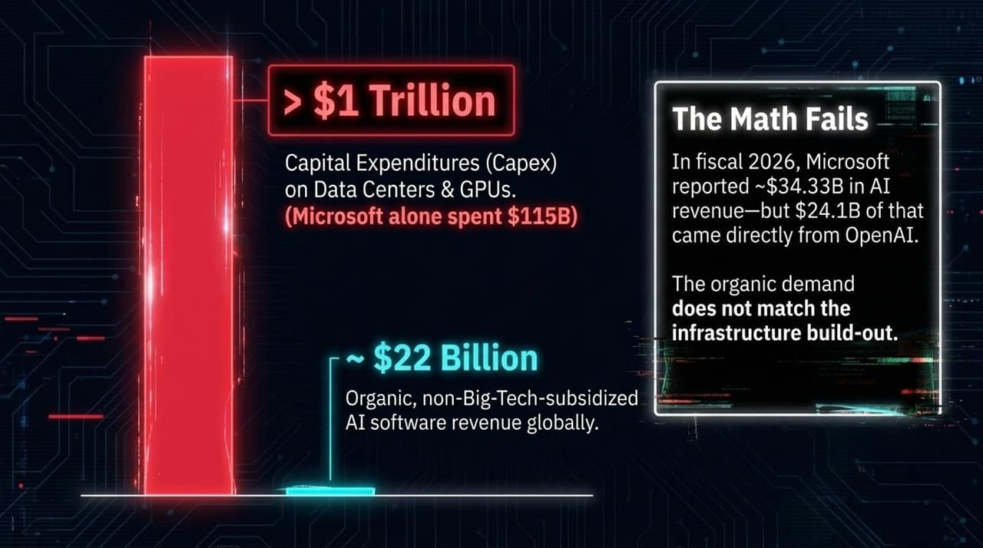
Notes:
Opening Hook:
How do tech giants report record AI growth when end-user adoption doesn't yield high returns? Through a circular financial loop.
Core Talking Points:
Step 1 (Funding): Tech giants like Microsoft, Amazon, and Google funnel billions of dollars into AI start-ups like OpenAI and Anthropic under the heading of 'strategic investments'.
Step 2 (Forced Recirculation): As a condition of these investments, OpenAI and Anthropic are contractually obligated to spend those funds on cloud infrastructure provided by Microsoft Azure, AWS, and Google Cloud.
Step 3 (Revenue Recognition): Cloud providers report these cloud compute purchases to Wall Street as genuine 'AI Cloud Revenue Growth,' pushing their stock valuations higher.
Step 4 (GPU Pumping): Cloud providers use these reported revenues to purchase hardware from Nvidia, boosting Nvidia’s earnings and market cap.
Key Takeaway:
An estimated 70% of AI cloud revenues are simply Big Tech cycling its own capital through proxy companies to manufacture the appearance of market demand.

Slide 7
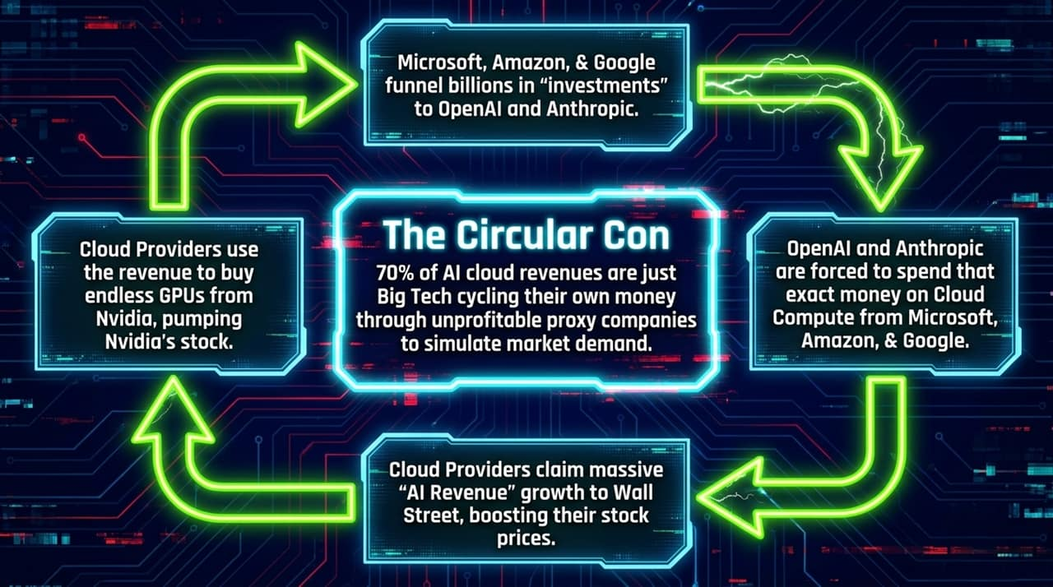
Notes:
Opening Hook:
AI proponents argue that scale will resolve these issues. However, scaling laws are running into real physical and economic limits.
Core Talking Points:
The Hardware & Cost Ceiling: Unlike traditional software or consumer electronics, there is no technical roadmap for exponential cost reductions in running large language model inference.
The Data Wall: AI models have consumed the majority of high-quality human text on the internet. Achieving marginal improvements now requires exponentially larger amounts of compute, power, and synthetic data.
False Equivalence with Traditional Software: Traditional Software as a Service (SaaS) scales with near-zero marginal cost per additional user. Generative AI requires continuous, high-cost electricity and hardware compute for every single token generated.
Key Takeaway:
Marketing promises project an exponential growth curve, but actual model capability is plateauing while marginal operational costs remain flat or rise.

Slide 8
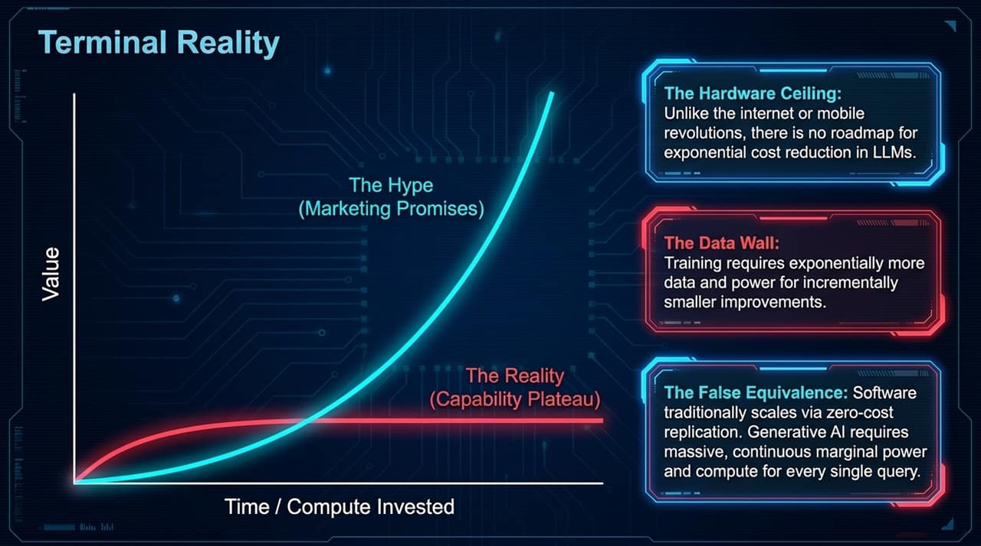
Notes:
Opening Hook:
The resource footprint required to power these models is historically unprecedented relative to the economic value generated.
Core Talking Points:
Comparison of Scale:
City of Bristol: Spans 1.2 billion sq. ft. and consumes roughly 7,800 MW of power annually to support a population of hundreds of thousands.
Stargate Abilene Facility (Texas): Covers just 998,000 sq. ft. (1,172 times smaller in land footprint) yet demands 1.2 Gigawatts (1,200 MW) of continuous annual power.
Resource Extraction:
To meet these intense power requirements, tech companies are relying on dedicated gas turbines, delaying green energy targets, and consuming vast quantities of water for cooling—all to operate loss-making AI text and image tools.
Key Takeaway:
The physical cost of Generative AI is hyper-concentrated power consumption and environmental degradation for low-margin digital utilities.

Slide 9
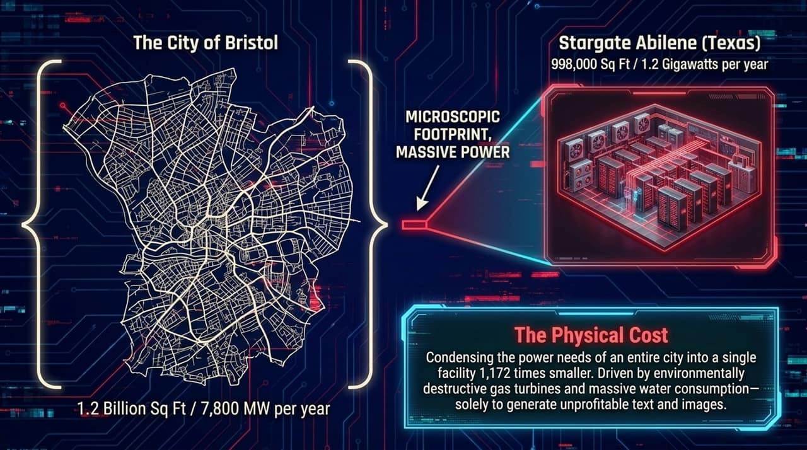
Notes:
Opening Hook:
We have seen a similar market dynamic before, but today's driver is structural stagnation in Big Tech core businesses.
Core Talking Points:
Dot-Com Bubble (1999): Driven by low-interest rates and over-building dark fiber networks under the assumption that web traffic would immediately monetize. When demand lagged behind infrastructure, dark fiber sat unused, and the market corrected.
GPU Overbuild (2024–Present): Follows the end of Zero Interest Rate Policy (ZIRP). Big Tech companies ran low on novel organic growth avenues for their core search, e-commerce, and social media businesses. Buying GPUs and deploying AI features serves as 'corporate Botox'—an expensive injection to signal youth and growth to Wall Street.
Key Takeaway:
AI spending is driven less by practical software demand and more by public companies trying to avoid single-digit growth valuations.

Slide 10
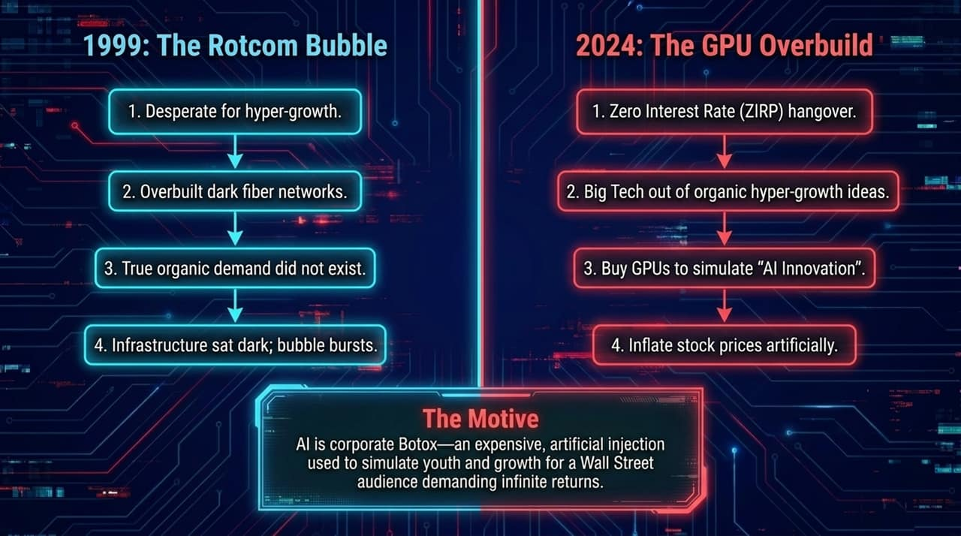
Notes:
Opening Hook:
When startup losses meet public market capital demands, the timeline to a liquidity wall becomes tight.
Core Talking Points:
OpenAI’s Financial Reality: Reported an operating loss of -$20.9 Billion in the last fiscal year.
Capital Requirements: OpenAI requires an estimated ~$100 Billion in annual capital injections to maintain infrastructure, train next-generation models, and retain specialized talent.
The IPO Bottleneck: Delayed initial public offerings mean these entities remain heavily dependent on private credit, venture capital, and cloud-provider subsidies.
Key Takeaway:
By 2027, model improvements face diminished returns, operating costs remain high, and private capital funding faces systemic exhaustion.

Slide 11
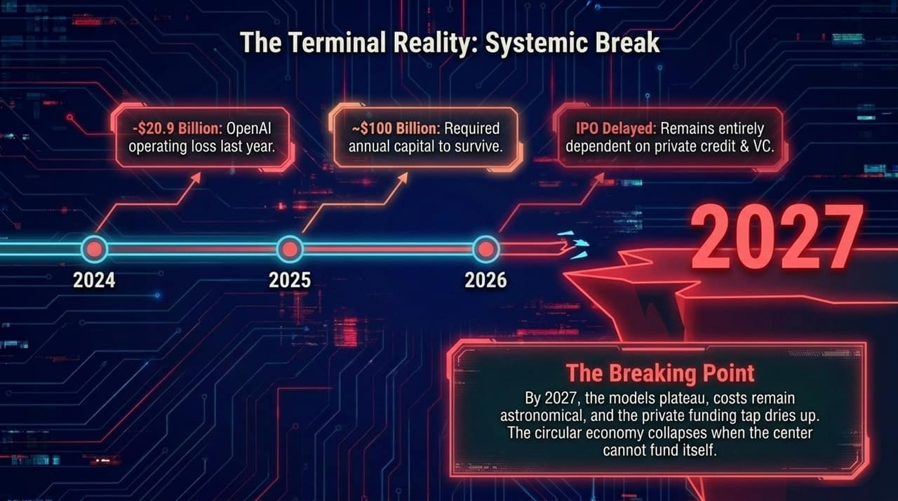
Notes:
Opening Hook:
If the center cannot fund itself, the unwinding of the circular economy will ripple across four distinct economic rings.
Core Talking Points:
Ring 1: The Core (AI Labs): Unprofitable research labs face liquidation, fire sales, or severe down-rounds as VC funding dries up.
Ring 2: The Hardware (Nvidia & Suppliers): As artificial compute demand contracts, orders for high-end GPUs decline. Nvidia’s revenues risk a projected 50% to 70% collapse back to baseline hardware demand levels.
Ring 3: Big Tech (Hyperscalers): Microsoft, Amazon, Alphabet, and Meta are forced to write down massive Capex assets, revise forward earnings guidance downward, and initiate deep cost-cutting layoffs.
Ring 4: The Macro Economy: Heavily concentrated stock indexes (like the S&P 500, dominated by the 'Magnificent 7') experience major contractions, impacting retirement funds and public equity markets.
Key Takeaway:
The 2027 liquidity wall represents a risk to the index-level stability of public equity markets.

Slide 12
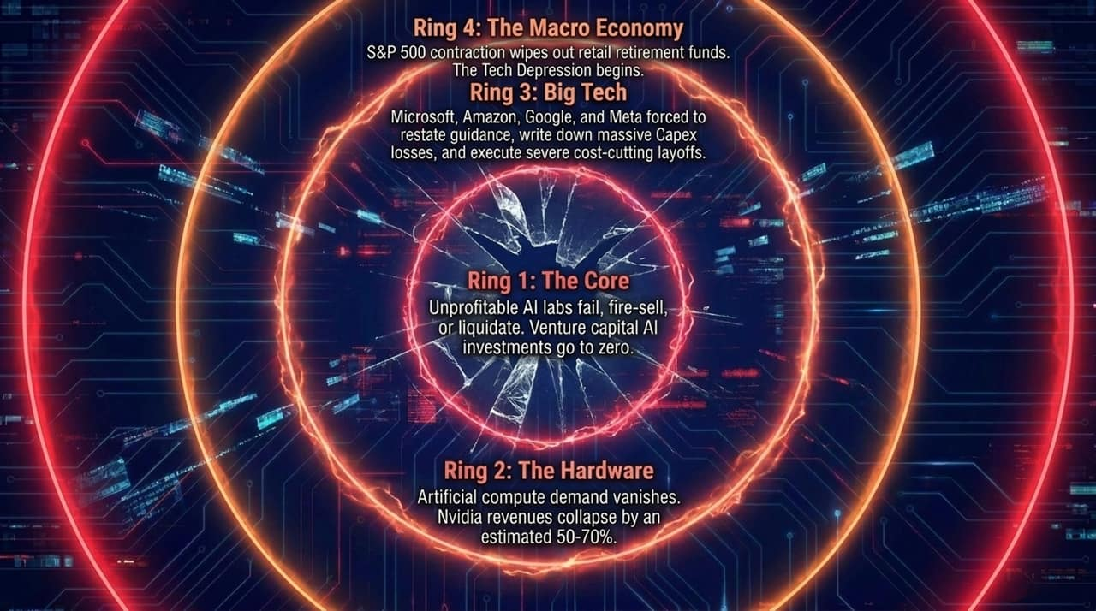
Notes:
Opening Hook:
Calling Generative AI a bubble does not mean all compute-heavy technology is useless. It is vital to separate speculative consumer hype from genuine, high-value compute applications.
Core Talking Points:
Filtered Out (The Generative Bubble):
Unreliable, probabilistic text generators (generic consumer chat).
Hallucination-prone search agents.
Low-cost automated SEO content mills and deepfake video generation.
Retained (True Value of Compute):
High-Performance Computing (HPC) applied to deterministic science.
DeepMind's AlphaFold, genomic sequencing, and protein folding.
Closed-system spatial physics modeling and specialized robotics.
Key Takeaway:
The future of technology is not a universal, all-knowing conversational agent, but narrow, domain-specific, deterministic compute.

Slide 13
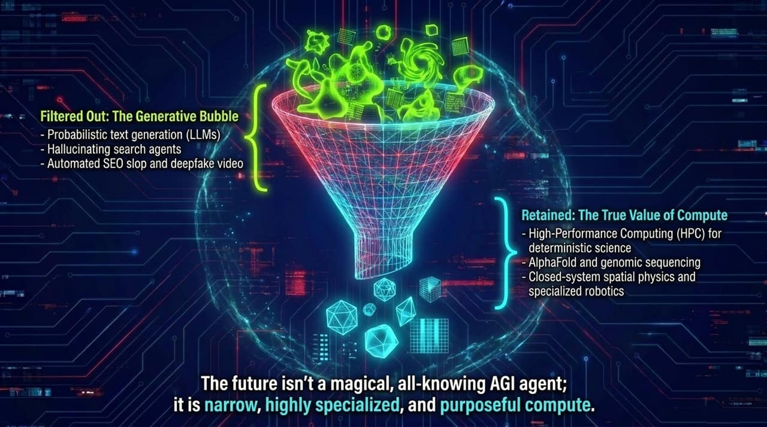
Notes:
Opening Hook:
To summarize the core structural thesis of the AI Con, we can break it down into four interconnected pillars.
Core Talking Points:
Artificial Adoption: Software features are pushed onto enterprise and consumer users without explicit request. Subsidized user fees mask unsustainable underlying compute costs.
Capability Plateau: LLMs remain probabilistic pattern-matching engines. Scaling compute scale no longer delivers proportional jumps in problem-solving reasoning.
The Circular Con: Hyperscalers funnel capital into proxy startups to book artificial cloud growth, inflating market capitalizations.
Mathematical Exhaustion: A combination of massive capital expenditures and deep operating deficits leads toward a structural liquidity reckoning by 2027.
Key Takeaway:
These four dynamics interact continuously, accelerating the timeline toward a market adjustment.

Slide 14
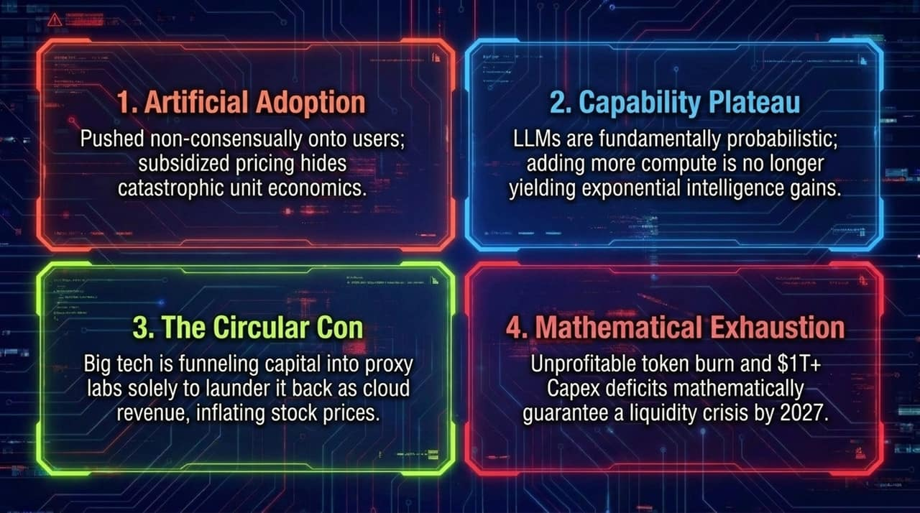
Notes:
Opening Hook:
In an economy flooded with machine-generated median content, what becomes genuinely valuable?
Core Talking Points:
Commoditization of Average Content: As generative models flood channels with synthetic text, code, and graphics, the marginal cost of producing baseline content drops to zero.
The Premium on Authenticity: Value shifts back toward non-commoditizable human traits: taste, context, accountability, strategic discernment, and real personal relationships.
Strategic Choice: Organizations that preserve human judgment and domain expertise will stand out, while those replacing core teams with unverified LLM output face quality issues.
Key Takeaway:
Resist the rush to automate core human judgment. Protect high-value work, original thinking, and authentic domain expertise.

Slide 15
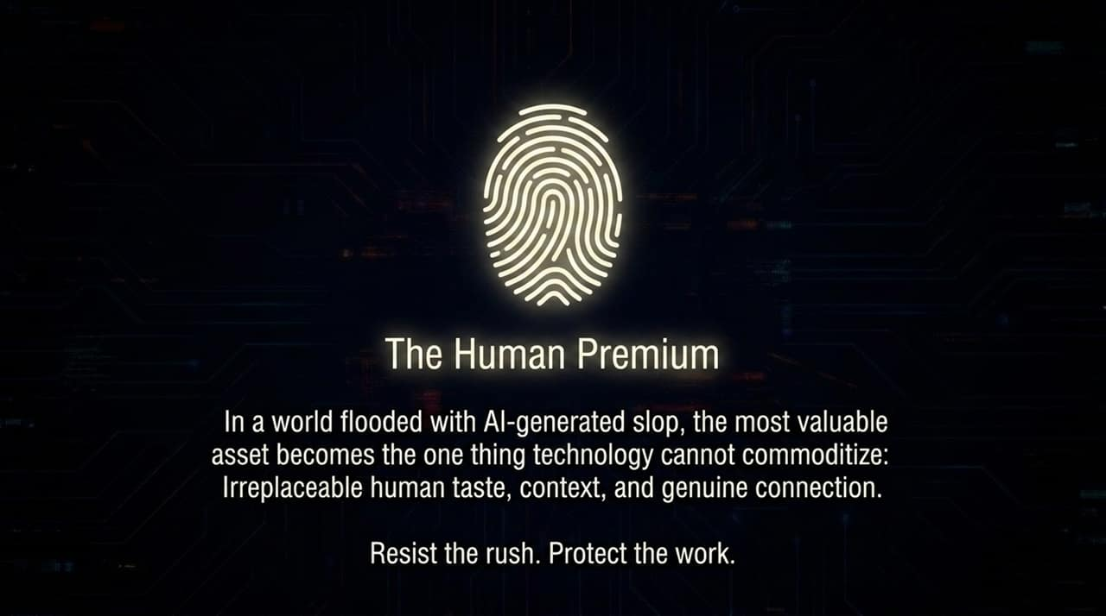
Notes:
Opening Hook:
This infographic synthesizes the economic loop and financial metrics defining the current market setup.
Core Talking Points:
The Financial Deficit: Highlight OpenAI's $20.9 Billion deficit despite global visibility, illustrating the gap between hype and cash flow.
The Per-User Subsidy Gap: Contrast the $20 monthly subscription fee paid by users against the $400 in actual token compute costs absorbed behind the scenes.
Comparative Metrics:
Microsoft's Capex: Projected $175 Billion in capital outlay.
Global Non-Big-Tech AI Market: Generates only ~$22 Billion in organic, non-subsidized revenue.
Systemic Risk: Pension and retail retirement funds are heavily concentrated in the market caps of the 'Magnificent 7' tech stocks, exposing retail investors to bubble downside.
Key Takeaway:
When infrastructure expenditures outweigh market software revenues by nearly 8-to-1, the market faces a sharp financial realignment.

Slide 16
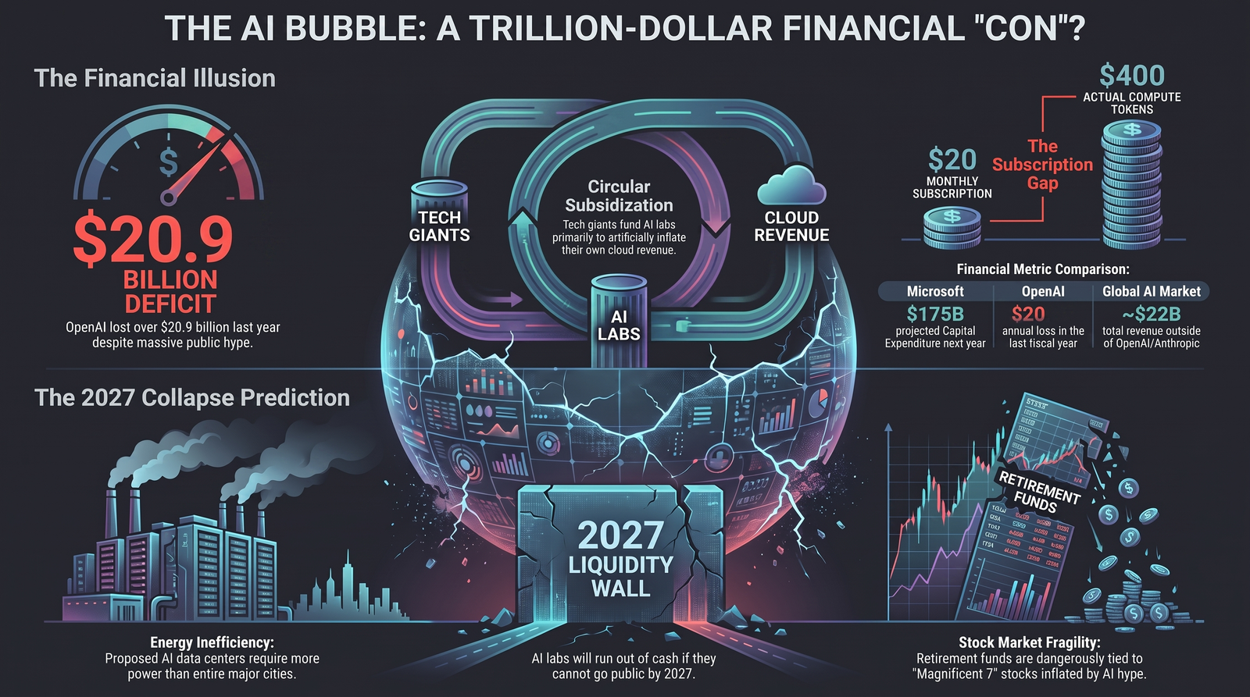
Notes:
Opening Hook:
To conclude our analysis, let's review the main takeaways for leaders, investors, and enterprise decision-makers.
Core Talking Points:
Differentiate Utility from Hype: Audit your organization's AI initiatives. Separate deterministic, high-efficiency tools from loss-making, low-accuracy generative workflows.
Prepare for Capital Realignment: Anticipate shifts in cloud service pricing as hyperscalers scale back subsidies and adjust enterprise pricing structures.
Focus on Fundamental Value: Allocate capital to core products, proprietary data assets, and human talent rather than relying entirely on third-party foundational models.
Closing Statement:
Thank you for your time. I am happy to open the floor to questions and discuss the data in detail.

